Slide 1
Leaf-Classification
Use deep learning to classify the species of leaf automatically.
Chia Hao Tang

Slide 2
Content
Motivation & Purpose
Data information
Setup
Result
Motivation
Purpose
Classify the species of leaf automatically?
Data source
Data file
Train.csv
Test.csv
Data feature
Margin
Shape
Texture
Preprocess data
Model structure
Model0
Model1
Model2
Model3
Model4
Model5
Fitting environment(each model is same)
Accuracy rate(Model0,Model1,Model2,Model3,Model4,Model5)

Slide 3
Motivation & Purpose
There are estimated to be nearly half a million species of plant in the world. Classification of species has been historically problematic and often results in duplicate identifications.
If we can create the classifier to classify the species of leaf automatically,it means we can create the model as botanist through the trained model with dataset of leaf.
My purpose is try building a classifier that uses the provided pre-extracted features.
Classify the species of leaf automatically?

Slide 4
Date information
Data source
Data feature
Data file
Data description
The data consists approximately 1,584 data of leaf specimens (16 samples each of 99 species) .
Feature type
Three sets of features are also provided per image: a shape(shape1~shape 64) contiguous descriptor, an interior texture(texture 1~texture 64) histogram, and a ﬁne-scale margin(margin 1~margin 64) histogram. For each feature, a 64-attribute vector is given per leaf sample.
File description
Train.csv(990 data containing 64 features and corresponding species)
Test.csv(594 data containing 64 features and no species)

Slide 5
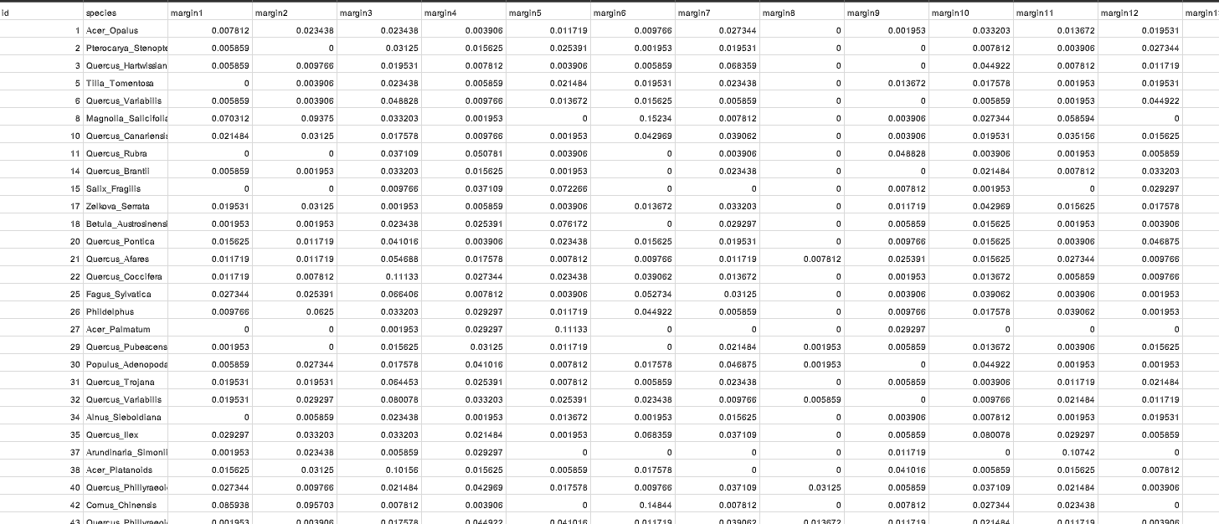


Data file (ex:Train.csv include 990 data)
Features of leaf
Tip
The data source is from Kaggle: https://www.kaggle.com/c/leaf-classification/data
Species of leaf

Slide 6
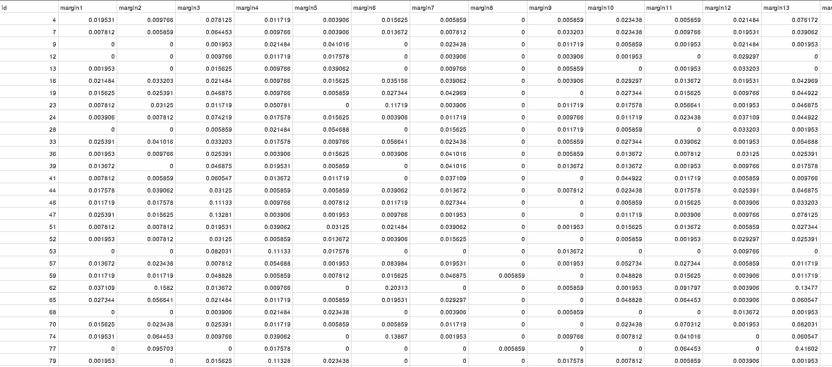
Data file (ex:Test.csv include 594 data)
Features of leaf
Tip
The data source is from Kaggle: https://www.kaggle.com/c/leaf-classification/data
No species(need to classify through trained model)

Slide 7
Setup
Processing data(Train data)
I.Encode the species of leaf and Split the train data of encoded species as “label”
II.Spilt the train data(label) into training data(label) and validation data(label).
III.Take the training and validation data into the array for fitting model’s shape and suitably identifying features.
Processing data

Slide 8
Setup
Processing data(Train data)
I.Encode the species of leaf and Split the train data of encoded species as “label”
II.Spilt the train data(label) into training data(label) and validation data(label).
III.Take the training and validation data into the array for fitting model’s shape and suitably identifying features.
Processing data

Slide 9
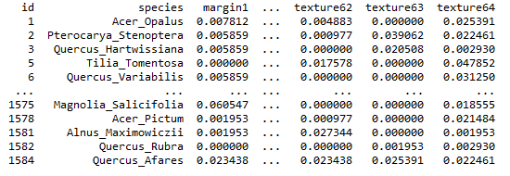
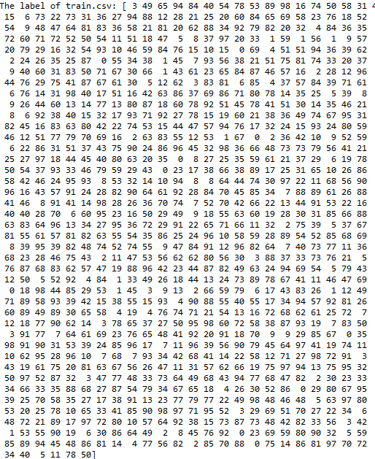
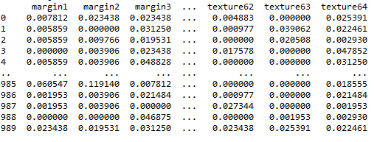
Encode the species of leaf and split the train.csv of encoded species as “label”
Train.csv
Split
Label
Train data

Slide 10
Setup
Processing data(Train data)
I.Encode the species of leaf and Split the train data of encoded species as “label”
II.Spilt the train data(label) into training data(label) and validation data(label).
III.Take the training and validation data into the array for fitting model’s shape and suitably identifying features.
Processing data

Slide 11
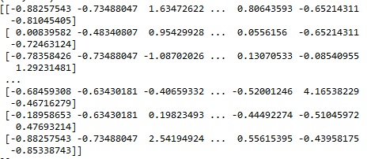
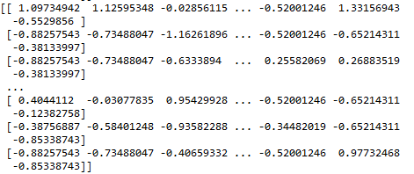
Spilt the train data(label) into training data(label) and validation data(label).
Train data(990 data)
[margin1,margin2,......]
[margin1,margin2,......]
Split
Training data(792 data)
Validation data(198 data)

Slide 12
Setup
Processing data(Train data)
I.Encode the species of leaf and Split the train data of encoded species as “label”
II.Spilt the train data(label) into training data(label) and validation data(label).
III.Take the training and validation data into the array for fitting model’s shape and suitably identifying features.
Processing data

Slide 13
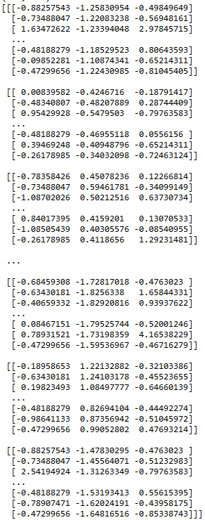
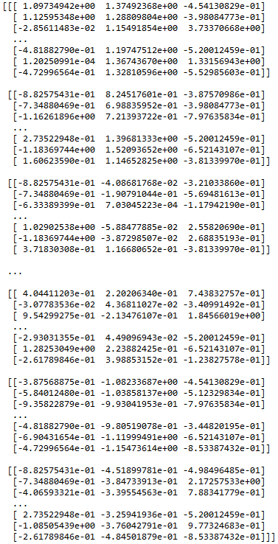
Take the training and validation data into the array for fitting model’s shape and suitably identifying features.
Training data(792 data),shape=(792, 192)
Validation data(198 data),shape=(198, 192)
reshape
reshape
Training data(792 data),shape=(792, 64,3)
Validation data(198 data),shape=(198, 64,3)
channel=[margin,shape,texture]

Slide 14
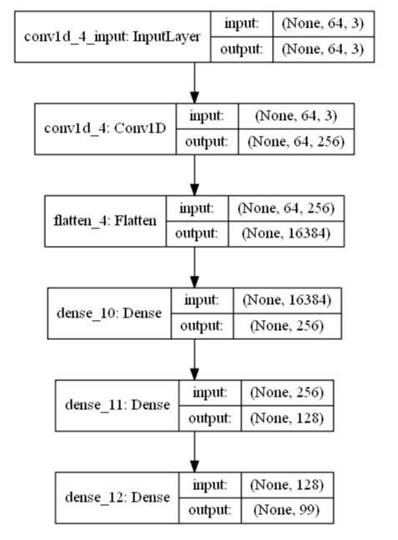
Setup
Input shape
Model Structure:Model0
Classifaciton number

Slide 15
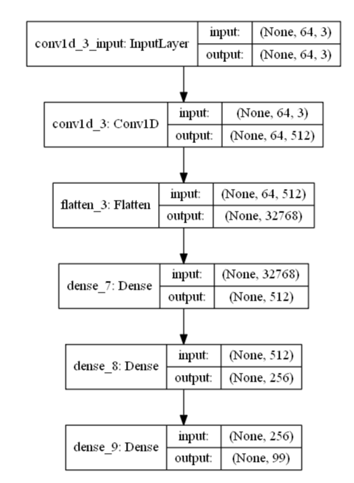
Setup
Input shape
Model Structure:Model1
Classifaciton number

Slide 16
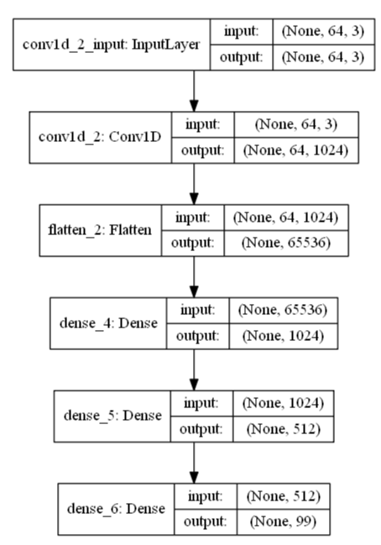
Setup
Input shape
Model Structure:Model2
Classifaciton number

Slide 17
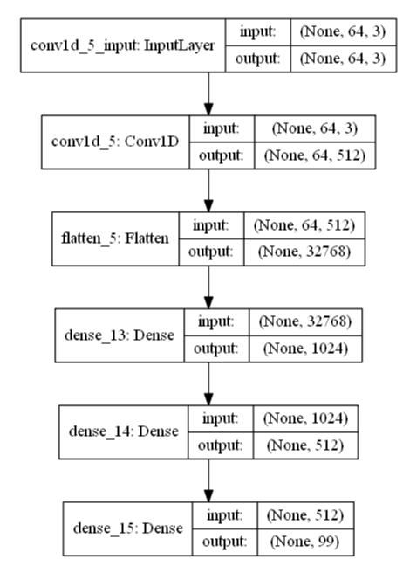
Setup
Input shape
Model Structure:Model3
Classifaciton number

Slide 18
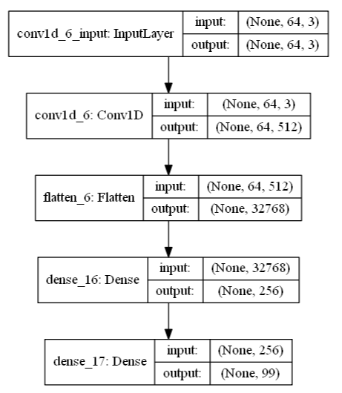
Setup
Input shape
Model Structure:Model4
Classifaciton number

Slide 19
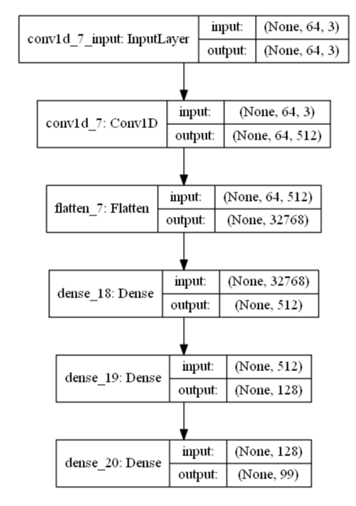
Setup
Input shape
Model Structure:Model5
Classifaciton number

Slide 20
Model structure
Model structure
Model0~Model5
6 depth layers
5 depth layers
Conv1d=512
dense_1=256
Model0~3,Model5
Model4
Conv1d=256 dense_1=256
dense_2=128
Conv1d=512 dense_1=512
dense_2=256
Conv1d=1028
dense_1=1028
dense_2=512
Conv1d=512
dense_1=1028
dense_2=512
Asia Lead
Europe Lead
Europe Lead
Vinny Viewer
Molly Maker
Molly Maker
Model0
Model1
Model2
Model3
Conv1d=512 dense_1=512
dense_2=128
Model5

Slide 21
Result
The fitting environment is(for each model) :
I.epochs=15
II.batch_size=16
III.Use the training data and validation data.
Fitting environment(same with each model)

Slide 22
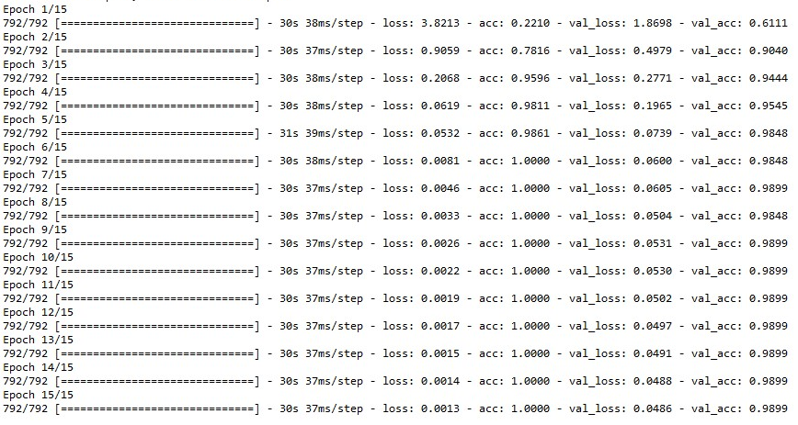
Fitting progress: Model0
Accuracy rate
Overfit happened

Slide 23
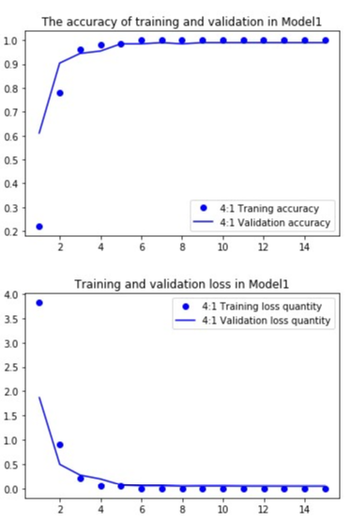
Result
Accuracy rate= 98.48%
Overfit happened epochs=9
Accuracy rate=98.48%
Accuracy rate=97.47%
Model0 result
Overfit
Overfit

Slide 24
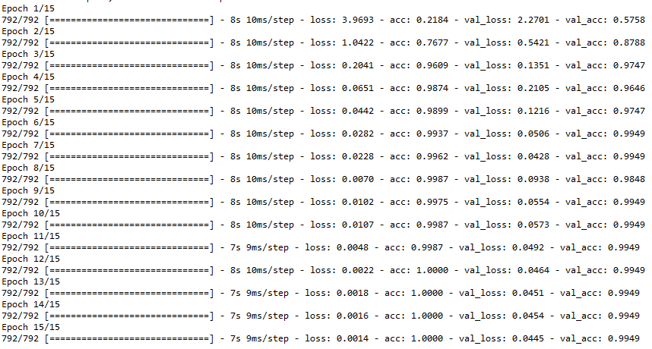
Fitting progress: Model1
Accuracy rate
Overfit happened

Slide 25
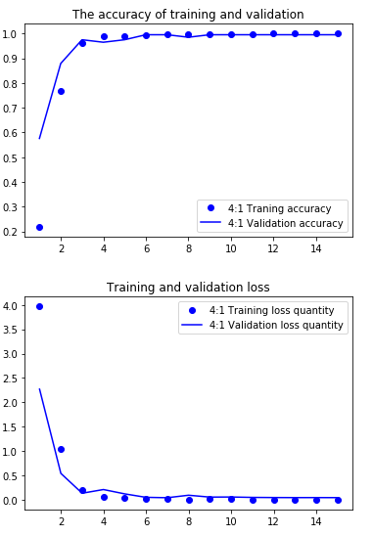
Result
Accuracy rate= 97.47%
Overfit happened epochs=4
Accuracy rate=97.47%
Model1
Overfit

Slide 26
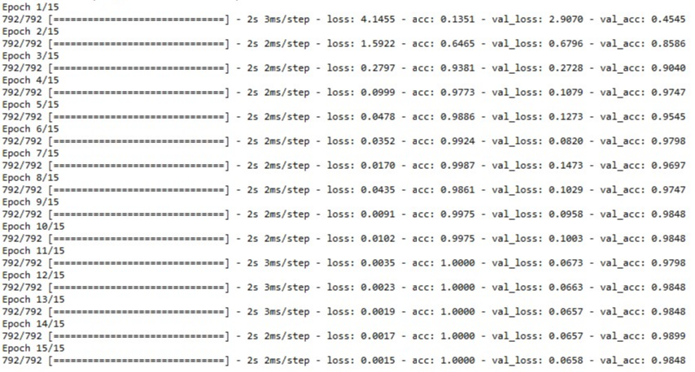
Fitting progress: Model2
Accuracy rate
Overfit happened

Slide 27
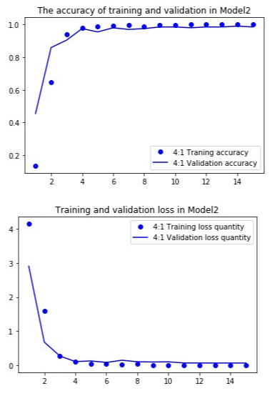
Result
Accuracy rate= 97.47%
Overfit happened epochs=5
Accuracy rate=97.47%
Accuracy rate=97.47%
Model2 result
Overfit
Overfit

Slide 28
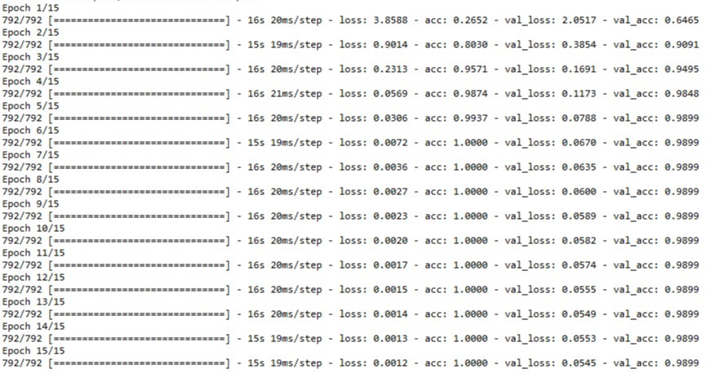
Fitting progress: Model3
Accuracy rate
Overfit happened

Slide 29
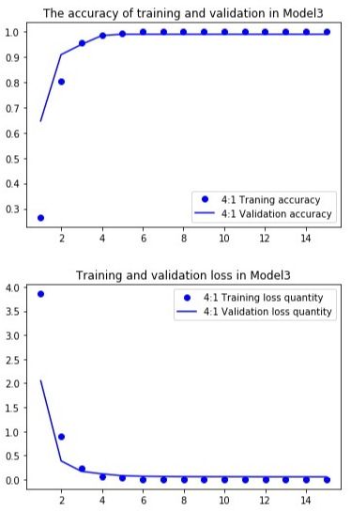
Result
Accuracy rate= 98.99%
Overfit happened epochs=14
Accuracy rate=98.99%
Accuracy rate=97.47%
Model3 result
Overfit
Overfit

Slide 30
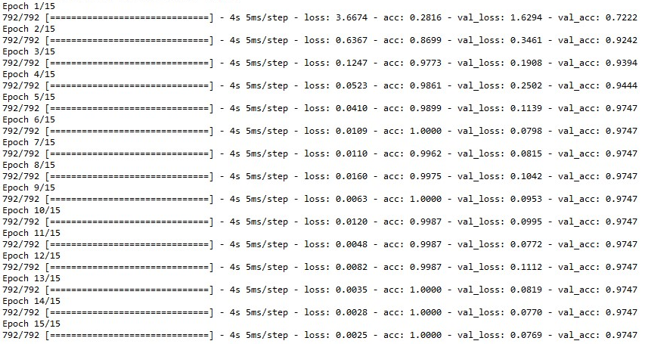
Fitting progress: Model4
Accuracy rate
Overfit happened

Slide 31
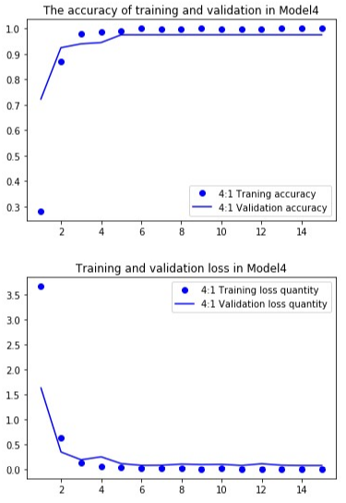
Result
Accuracy rate= 97.47%
Overfit happened epochs=7
Accuracy rate=97.47%
Model4 result
Overfit

Slide 32
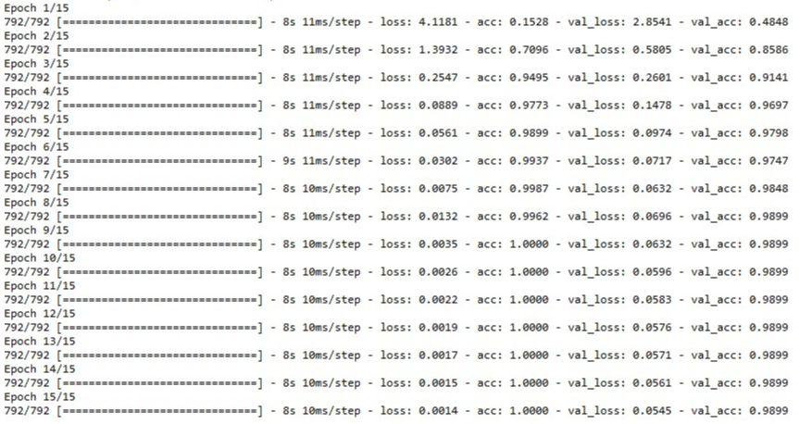
Fitting progress: Model5
Accuracy rate

Slide 33
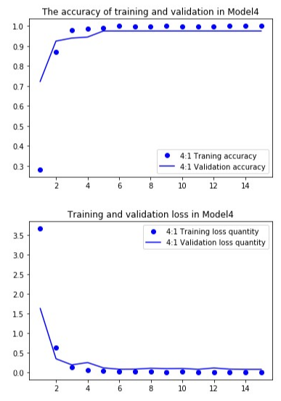
Result
Accuracy rate= 98.99%
Overfit happened epochs=None
Accuracy rate=97.47%
Model5 result

Slide 34
Accuracy rate
Model structure
Model1,Model2,Model4
Model3,Model5
Model structure
Model0~Model5
6 depth layers
5 depth layers
Conv1d=512
dense_1=256
97.47%
98.48%
98.99%
Model0~3,Model5
Model4
Conv1d=256 dense_1=256
dense_2=128
Conv1d=512 dense_1=512
dense_2=256
Conv1d=1028
dense_1=1028
dense_2=512
Conv1d=512
dense_1=1028
dense_2=512
Asia Lead
Europe Lead
Europe Lead
Vinny
Molly
Molly
Model0
Model1
Model2
Model3
Model0
Conv1d=512 dense_1=512
dense_2=128
Model5

Slide 35
Conclusion
I.In our simulation,the model3 and model5 have highest accuracy rate in 6 different models.
II.In future, we can try more different model to find the more high accuracy rate of model. Regrettably, there is no rule and precise theory to build the model which has absolute highest accuracy rate.
III.We used the CNN layer as our first layer to achieve to classify the species of leaf, and the model we build has approximately 97.47%~98.99% accuracy rate.

